Slide 2
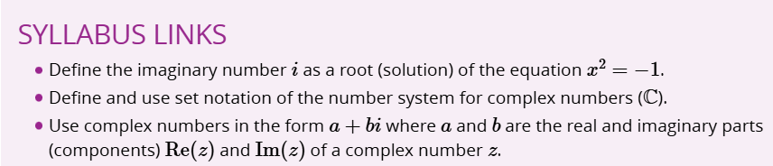
Learning Goal
To overview Complex number system and equate complex numbers to the imaginary component, “i”, or the square root of -1.
To identify real and imaginary parts of a Complex number

Slide 3
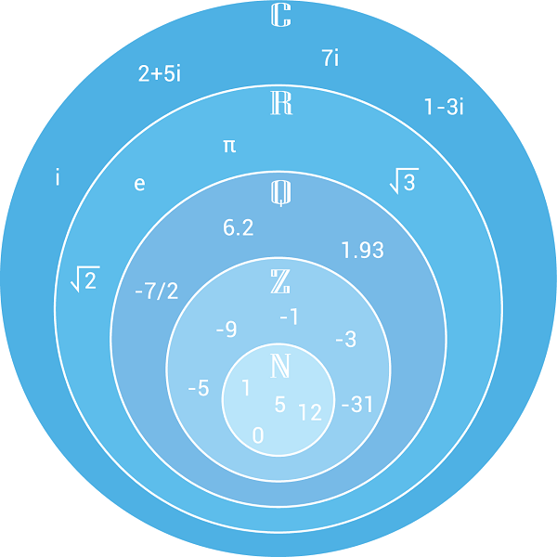

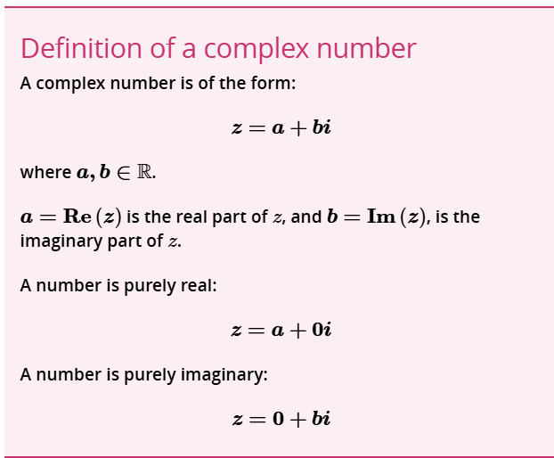
The complex number system
The basis for complex numbers is the imaginary number:

